Slide 1
Logistics Optimization for Delivery Routes SQL Data Analytics Project
Name: Aryan Dubey
Course: SQL for Data Analysis
Database: PostgreSQL
Tools Used: PostgreSQL, SQL

Slide 2
Project Overview
The goal of this project is to analyze logistics delivery data using SQL to identify inefficiencies, delays, and performance bottlenecks in the delivery network.
Dataset Includes
Orders Table
Routes Table
Warehouses Table
Delivery Agents Table
Shipment Tracking Table
Database Used
PostgreSQL

Slide 3
Dataset Description
Tables Information
• Orders Table – Contains delivery dates and order status • Routes Table – Contains route distance and traffic delay • Warehouses Table – Stores warehouse location and processing time • Delivery Agents Table – Agent details and performance metrics • Shipment Tracking Table – Tracks shipment checkpoints and delay reasons

Slide 4
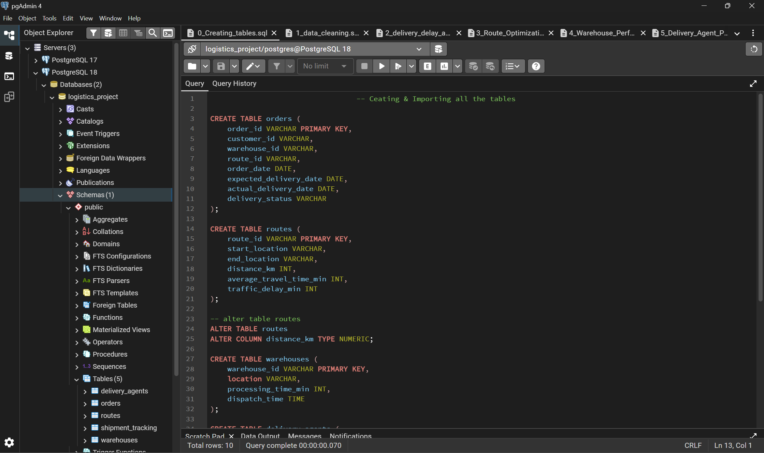
Database Schema
Screenshot of logistics project database
Tables Used
Orders
Routes
Warehouses
Delivery Agents
Shipment Tracking

Slide 5
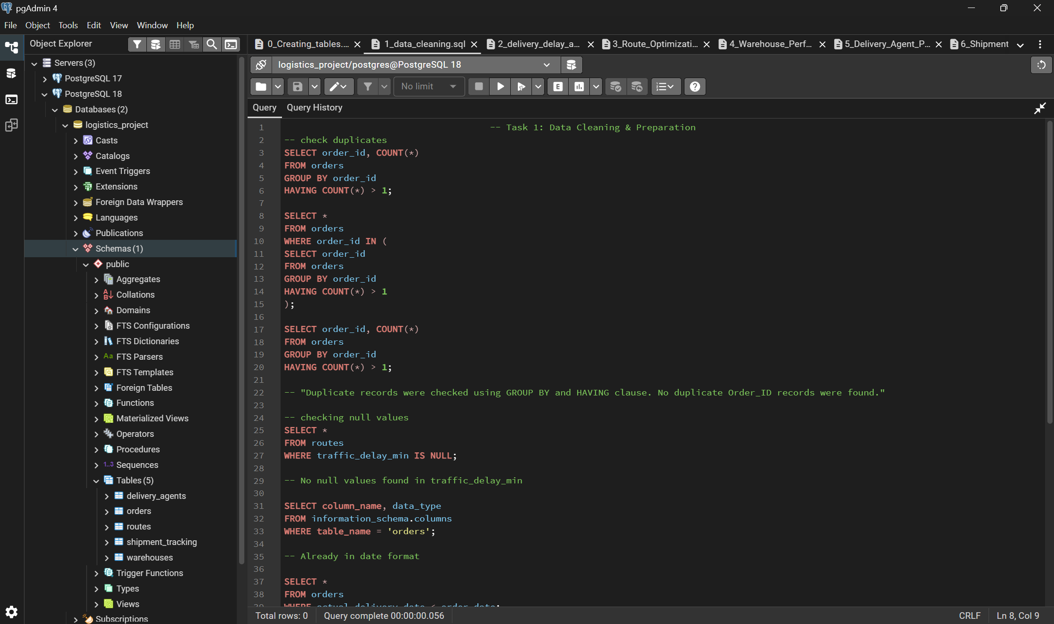
Task 1: Data Cleaning
• Checked for duplicate records in orders table • Verified missing values in dataset • Cleaned inconsistent values • Ensured data integrity before analysis

Slide 6
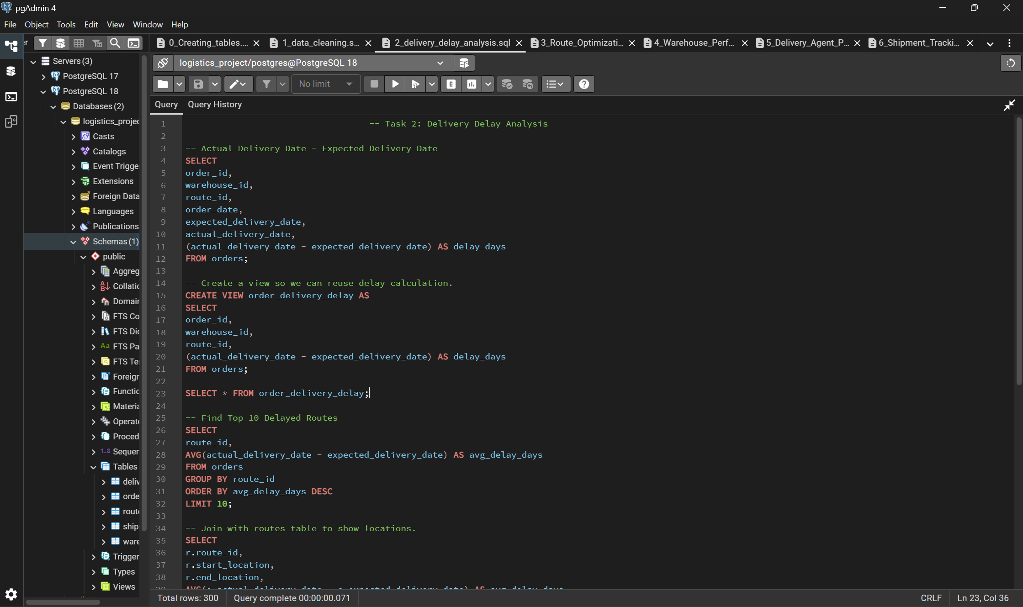
Task 2: Delivery Delay Analysis
Delivery delay calculated using:
Actual Delivery Date – Expected Delivery Date
Key Analysis:
• Identified delayed deliveries • Ranked delays within each warehouse

Slide 7
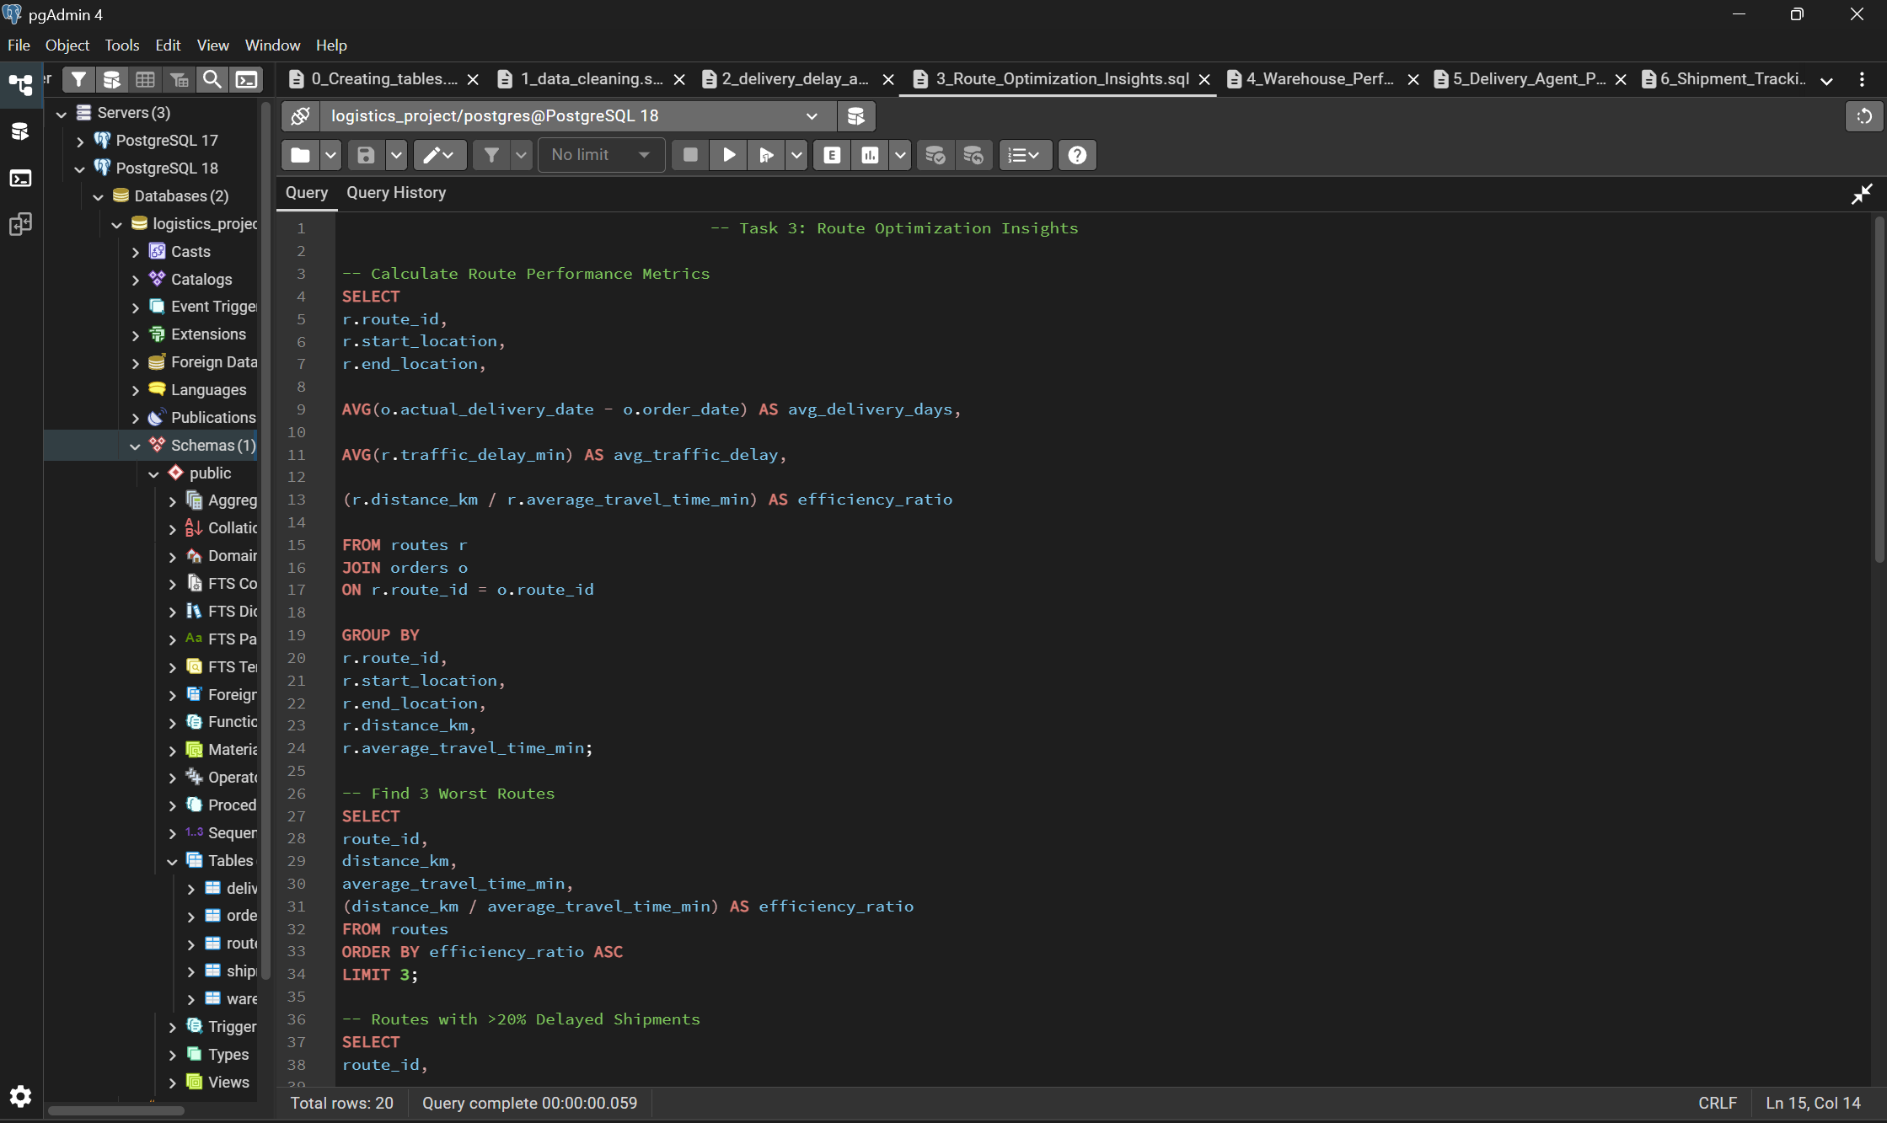
Task 3: Route Optimization Analysis
• Calculated average travel time per route • Analyzed traffic delay impact • Identified routes with highest delays
Key Insight:
Some routes experience higher delays due to traffic congestion.

Slide 8
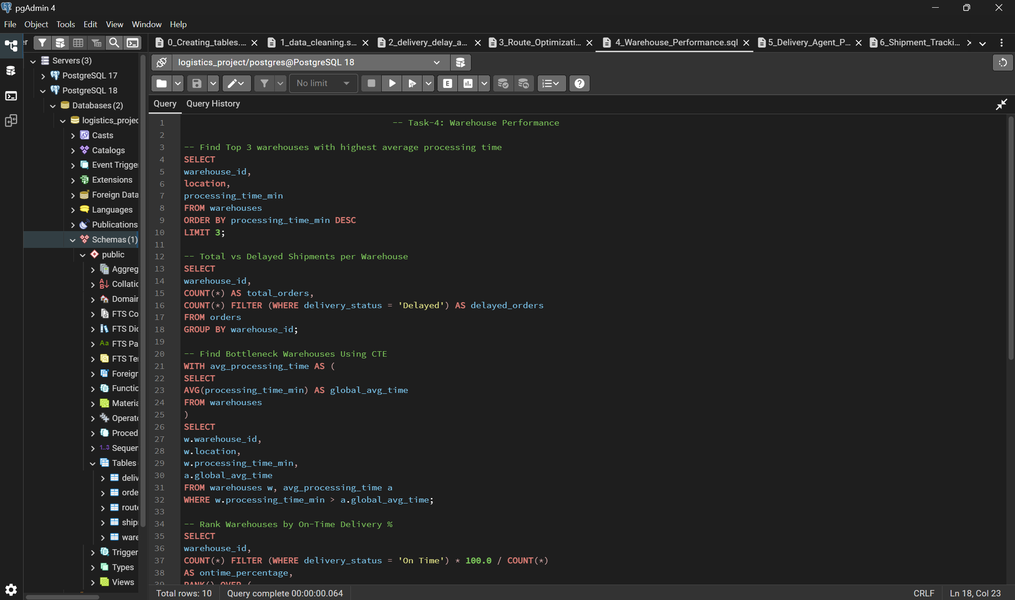
Task 4: Warehouse Performance Analysis
• Compared warehouse processing times • Calculated on-time delivery percentage • Identified warehouses with slower processing
Key Insight:
Improving warehouse operations can reduce delivery delays.

Slide 9
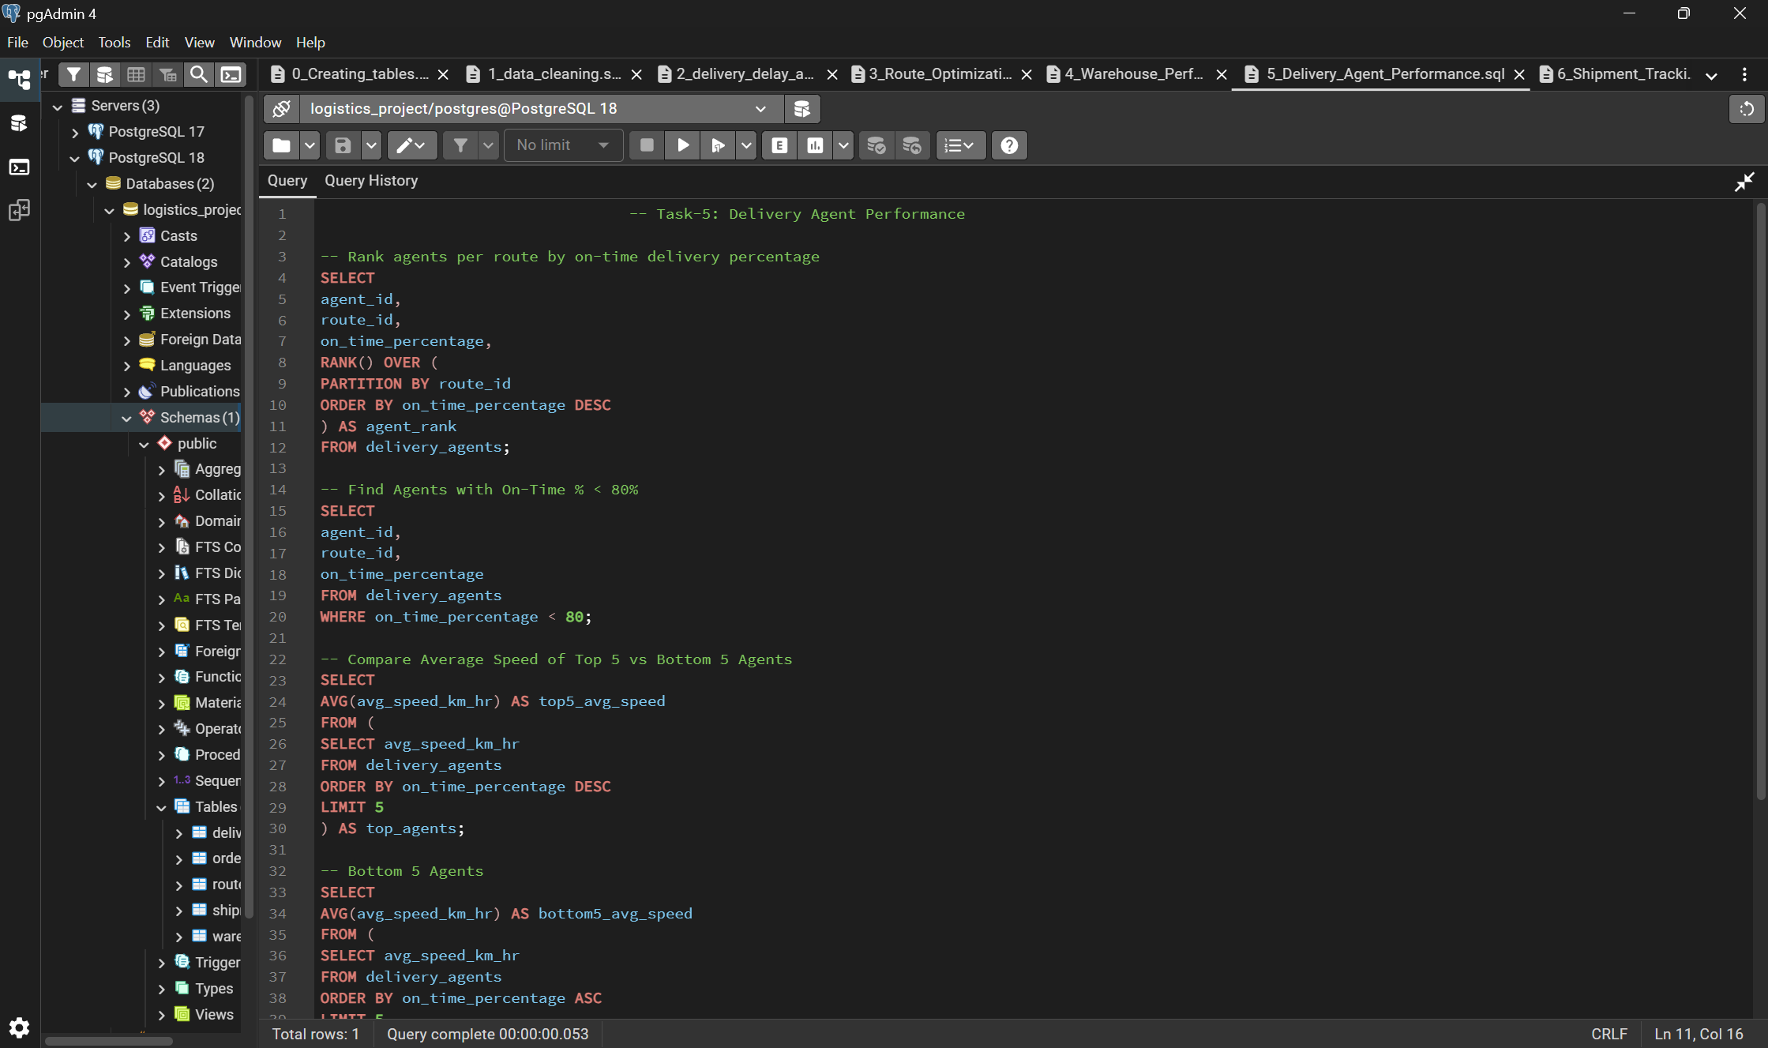
Task 5: Delivery Agent Performance
• Ranked delivery agents by on-time delivery percentage • Identified underperforming agents • Compared top and bottom performing agents
Key Insight:
Higher performing agents maintain better delivery efficiency.

Slide 10
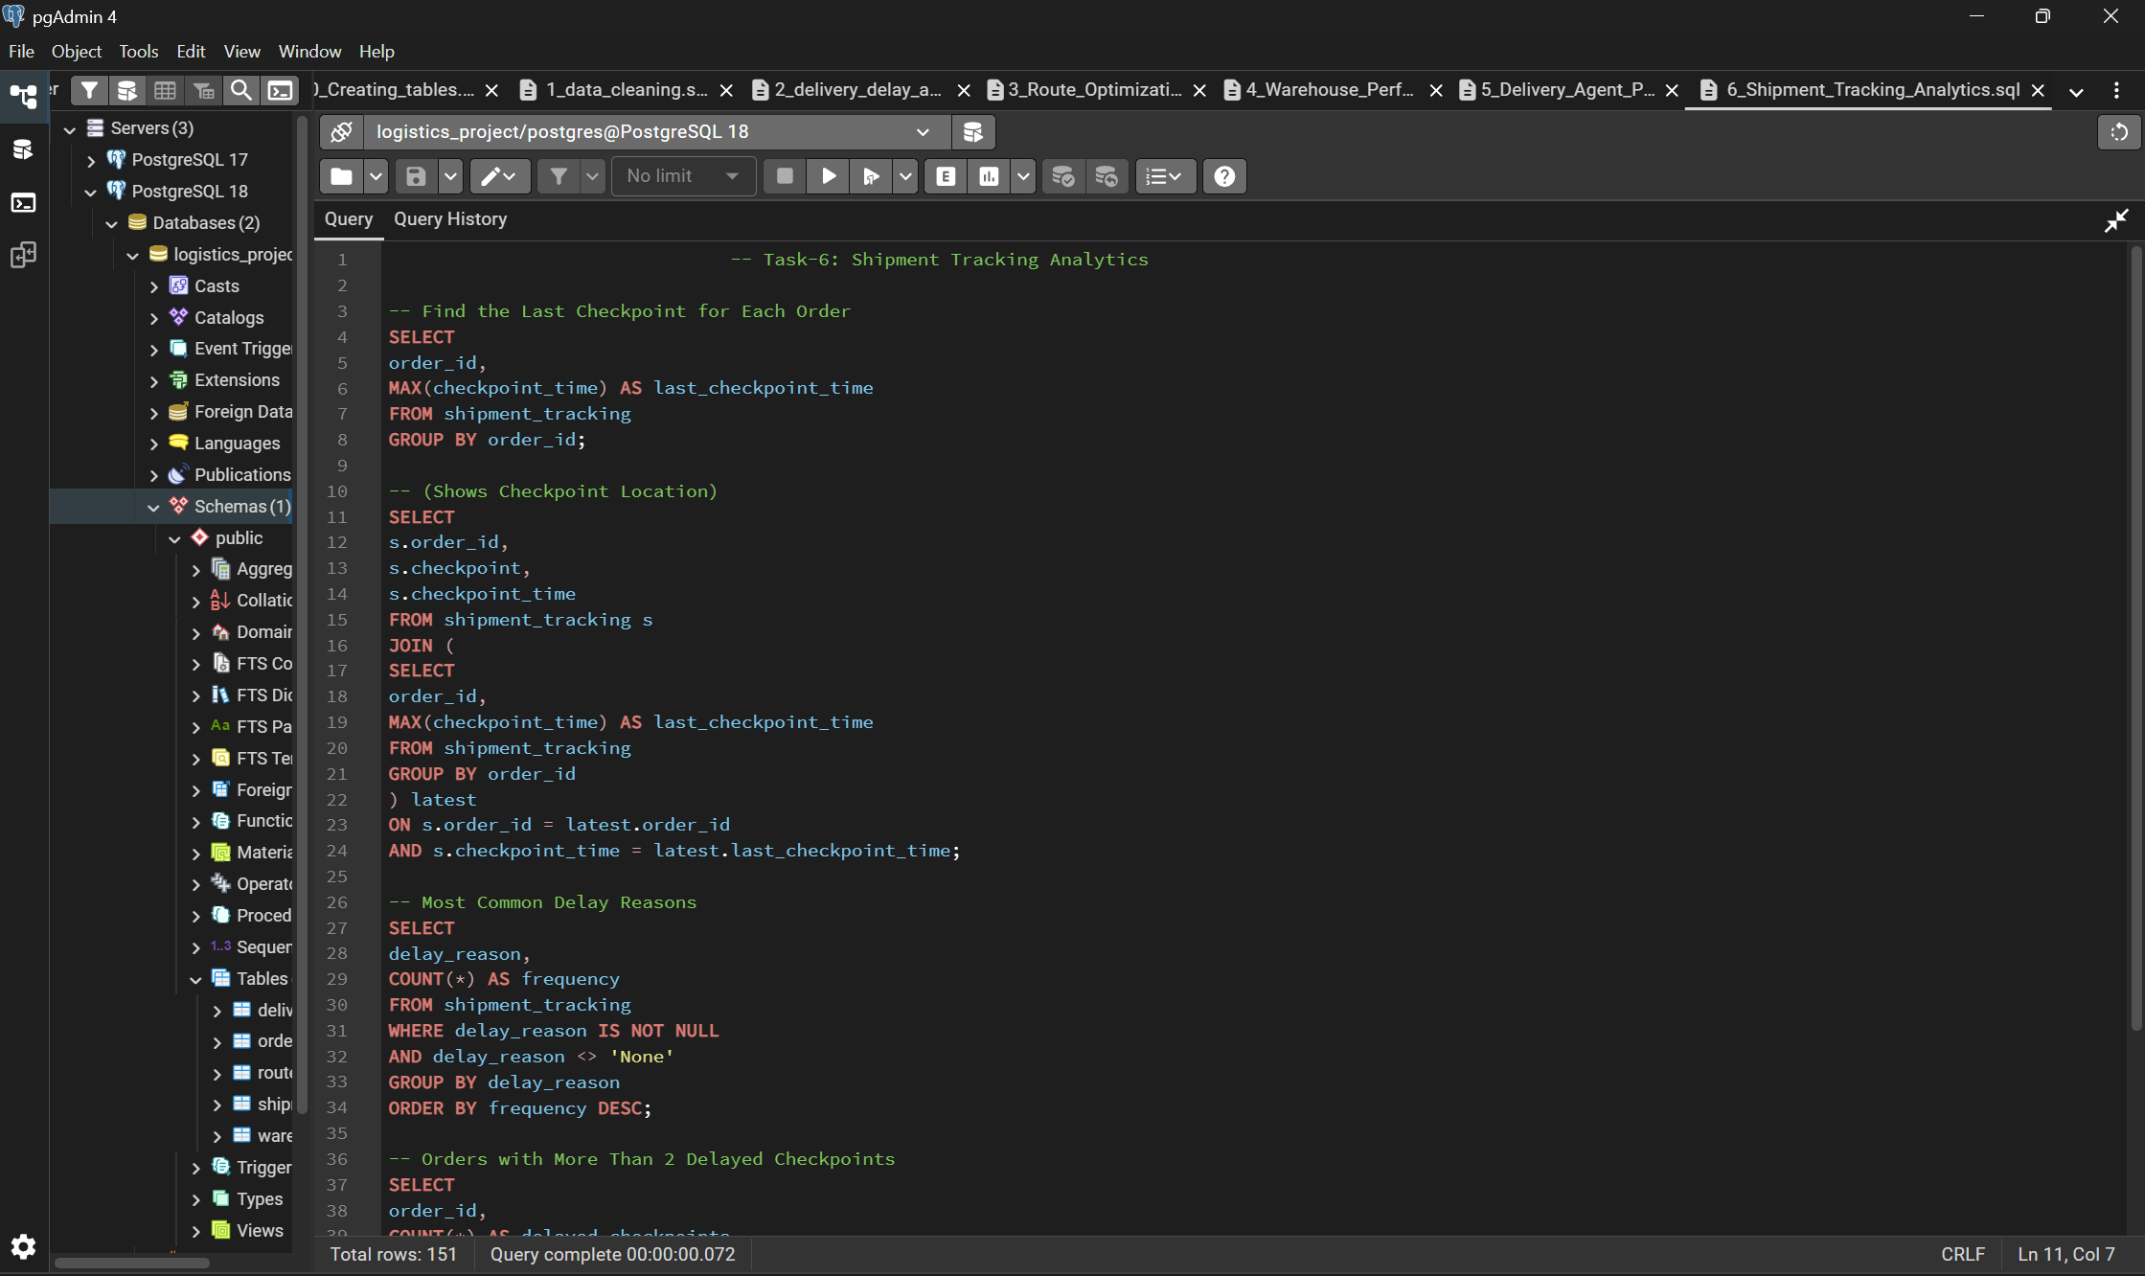
Task 6: Shipment Tracking Analytics
Key Findings:
• Sorting Delay – 272 cases • Weather Delay – 263 cases • Traffic Delay – 247 cases
151 shipments had multiple delayed checkpoints.

Slide 11
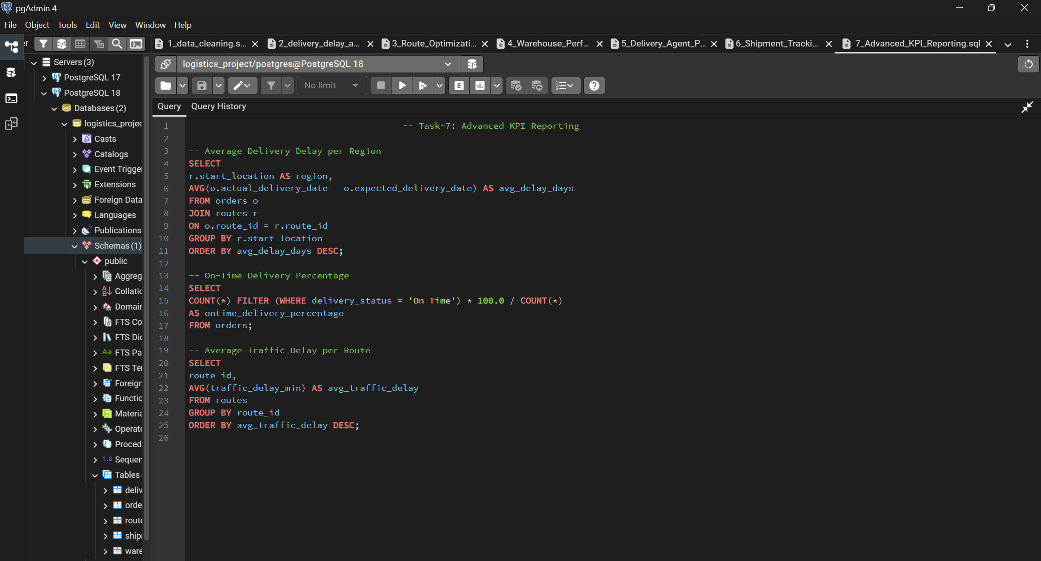
Task 7: Advanced KPI Reporting
Key KPIs calculated:
• Average delivery delay per region • On-time delivery percentage (56%) • Average traffic delay per route
Highest traffic delay route:
R014 – 58 minutes

Slide 12
Conclusion
Logistics data was analyzed using SQL queries.
Major delay causes: Sorting, Weather, and Traffic.
Several routes and regions show higher delivery delays.
Overall, on-time delivery rate is 56%.
High-speed agents achieve better on-time deliveries.
151 orders experienced multiple delayed checkpoints.
Routes R014 and R007 have the highest traffic delays.
Recommendation:
Improve route optimization and warehouse processing efficiency.

Slide 13
Project Explanation Video
Click Here: Ctrl + Click
https://drive.google.com/file/d/1OOC3OfhTKwXdFpOyuLYHR3QSqobrPYrb/view?usp=sharing

Slide 14
Thank You

